Slide 1
Project Presentation of Industry Oriented Hands-on Experience (IOHE)
On
MediHub
“Core of Medical Supplies”
Ashima Yadav (2010991503)
Aayush (2010990811) Tanya Dua (2010990725)
Supervised By
Mr. Abhishek
Department of Computer Science and Engineering,
Chitkara University, Punjab

Slide 2
OBJECTIVE
MediHub is the Healthcare E-commerce Platform, an innovative online E-commerce platform.
It is designed to facilitate the purchase of medical supplies, medicines, and healthcare products.
It offers a convenient and efficient way for users to access a wide range of medical items from the comfort of their homes.

Slide 3
PROBLEM
Limited Access: Many people face challenges in accessing essential medical supplies, especially in remote areas or during emergencies.
Time Constraints: Visiting physical pharmacies can be time-consuming, particularly for individuals with busy schedules or mobility issues.
Product Variety: Traditional pharmacies may have limited stock, leading to a lack of availability for certain medical products.

Slide 4
SOLUTION
Nationwide Access: MediHub delivers essential medical supplies nationwide, ensuring accessibility even in remote areas or during emergencies.
Time-Saving Convenience: Users can shop for medical supplies online, saving time compared to visiting physical pharmacies, ideal for busy individuals.
Extensive Product Range: MediHub's website offers a wide selection of medical supplies, medicines, and healthcare products, catering to diverse needs and preferences.

Slide 5
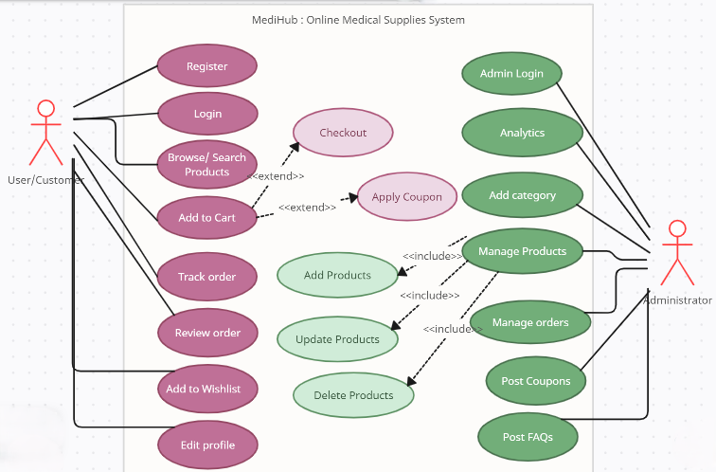
Use Case Diagram

Slide 6
FEATURES
User Registration and Login: Secure registration and login system for users to create accounts and access the platform.
Product Catalog: Comprehensive catalog featuring a wide range of medical supplies, medicines, and healthcare products.
Shopping Cart: Virtual shopping cart for users to add, remove, and manage their selected items before checkout.
Secure Payment Gateway: Integration with secure payment gateways for safe and hassle-free transactions.
Search : Advanced alphabetic search to help users find specific products quickly.
Order Tracking: Real-time order tracking functionality to keep users informed about the status of their purchases.

Slide 7
Feedback : Option for users to leave feedback for products and sellers.
Wishlist: Option for users to wish list products for later.
User Profile Update: Updating user profile, adding profile picture and change password.
FaQ’s: FaQ’s answered by admin
Admin Panel: Admin dashboard for managing products, users, orders, and other aspects of the platform including analytics.
Coupons : Additional coupons for discount
Responsive Design: Mobile-friendly design ensuring seamless access across devices.

Slide 8
TECHNOLOGIES USED
Frontend
Angular JS
HTML (Hypertext Mark up Language)
SCSS (Sassy Cascading Style Sheets)
Bootstrap (Front-end framework)
Backend
Java
Hibernate
Spring Boot
MySQL (Relational database management system)
JWT
Spring Tool Suite
Lombok

Slide 9
MediHub’s Delivery Strategies
In-House Delivery Team: Inspired by the successful models of Swiggy and Zomato, we‘ll be implementing our own delivery team. Not only does this strategy create job opportunities, but it also allows us better control over delivery operations, ensuring timely and efficient service.
Partnering with external delivery companies could limit our ability to negotiate terms. By managing our own team, we retain flexibility and control over costs, minimizing the risk of losses and maximizing profitability.

Slide 10
MediHub`s Marketing Strategy
INFLUENCER MARKETING
Collaborate with influencers or healthcare professionals who have a significant following in our target market.
Have them endorse our products or share their experiences with our brand
ONLINE ADVERTISMENT
Marketing campaigns to reach users to visit our website, and experience the benefits which our website provides.

Slide 11
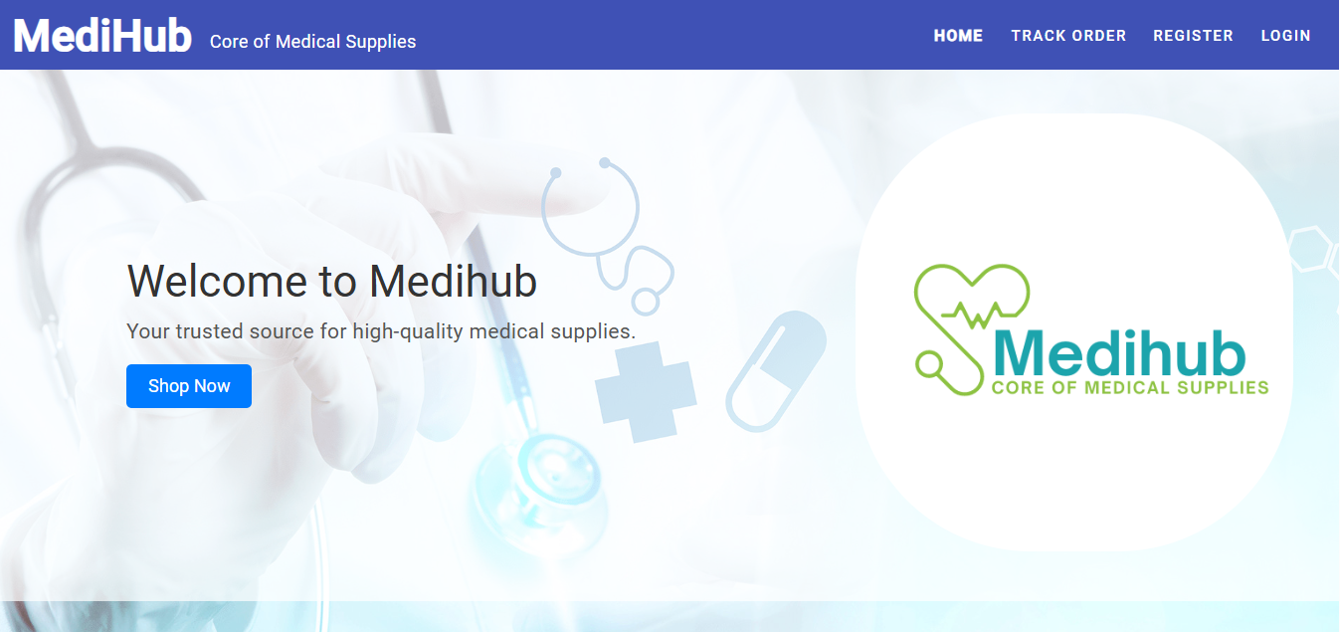
Snapshots

Slide 12
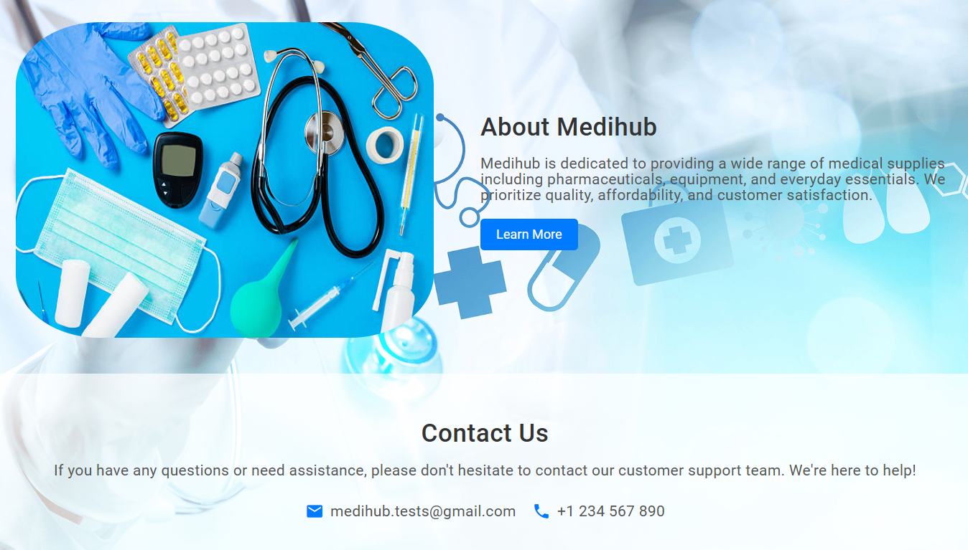
Snapshots

Slide 13
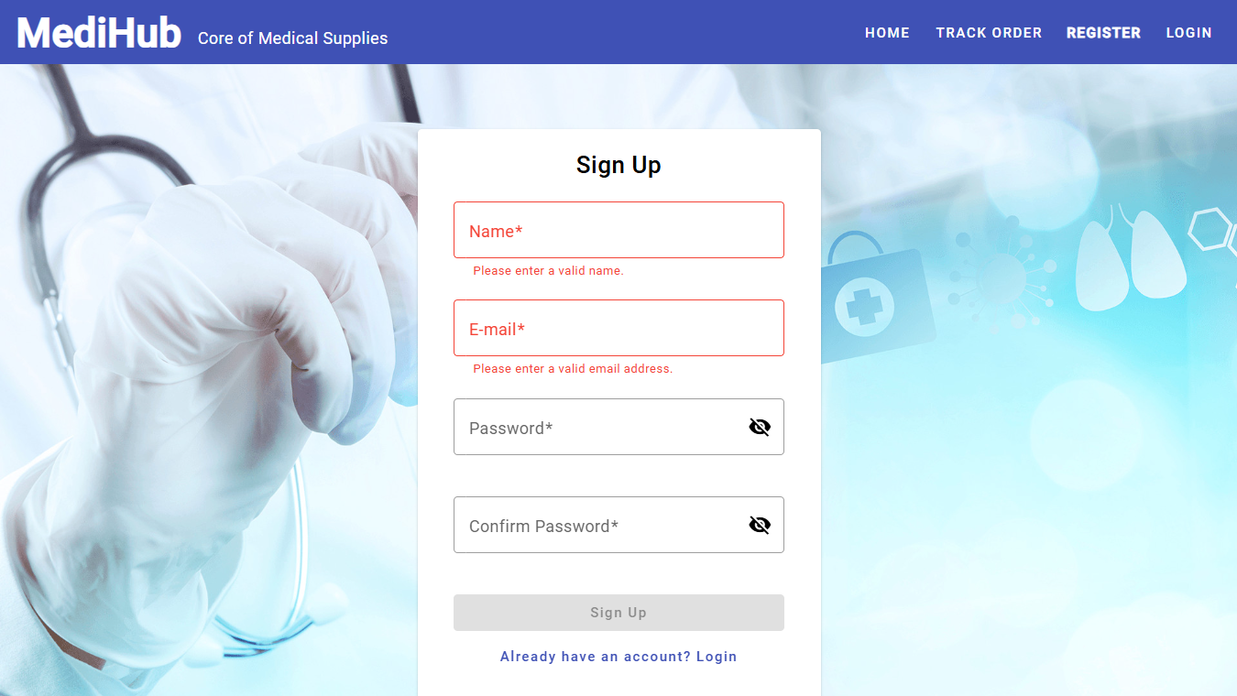
Snapshots

Slide 14
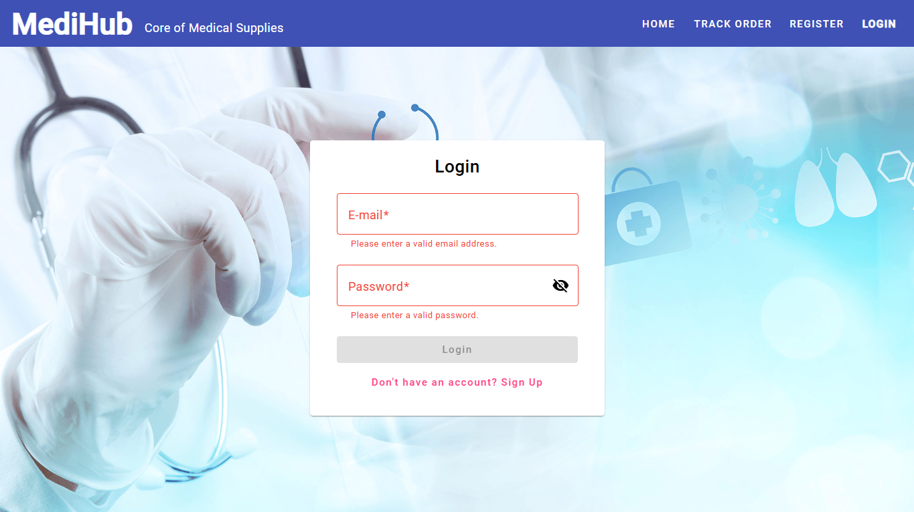
Snapshots

Slide 15
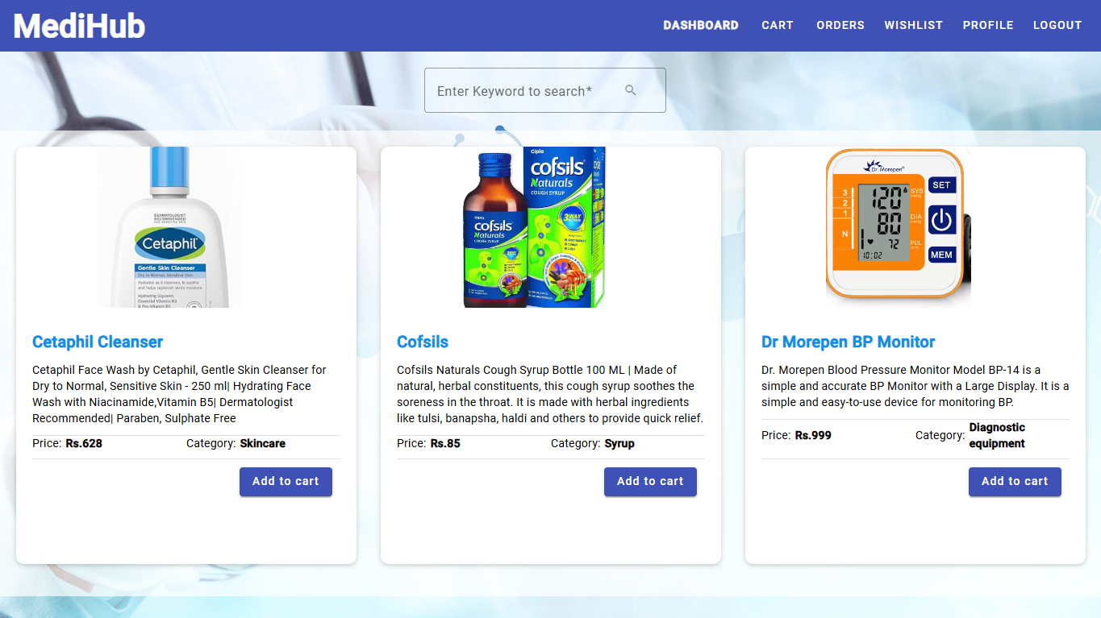
Snapshots

Slide 16
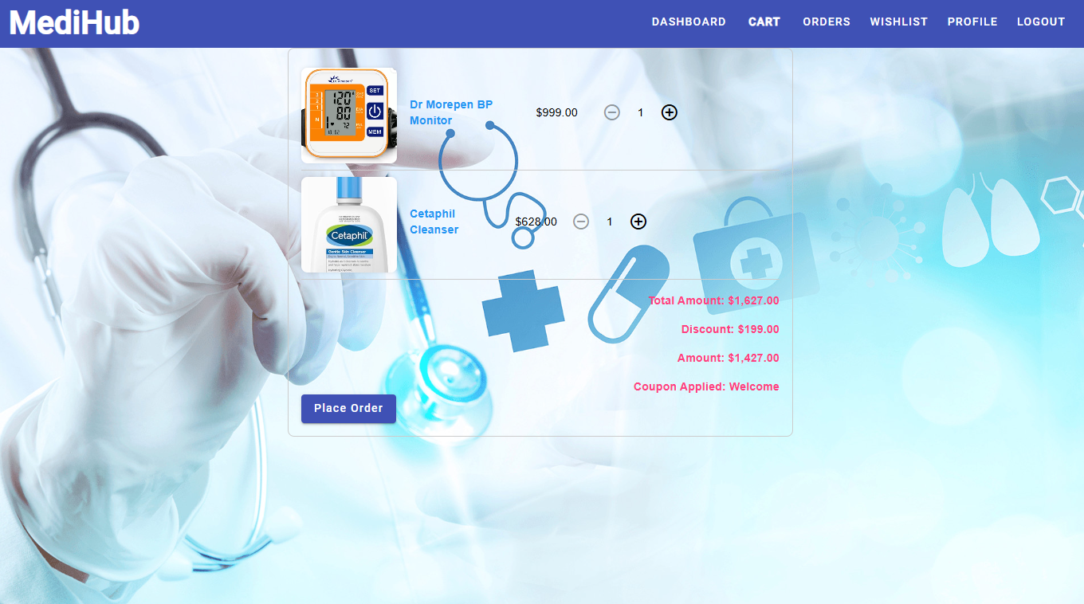
Snapshots

Slide 17
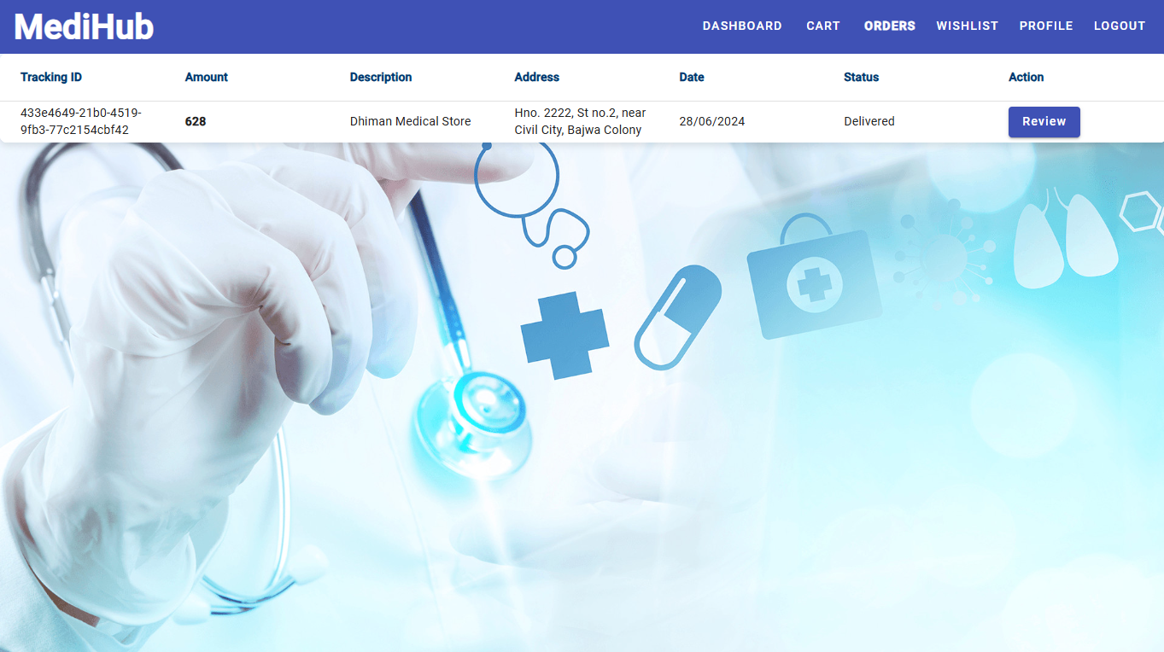
Snapshots

Slide 18
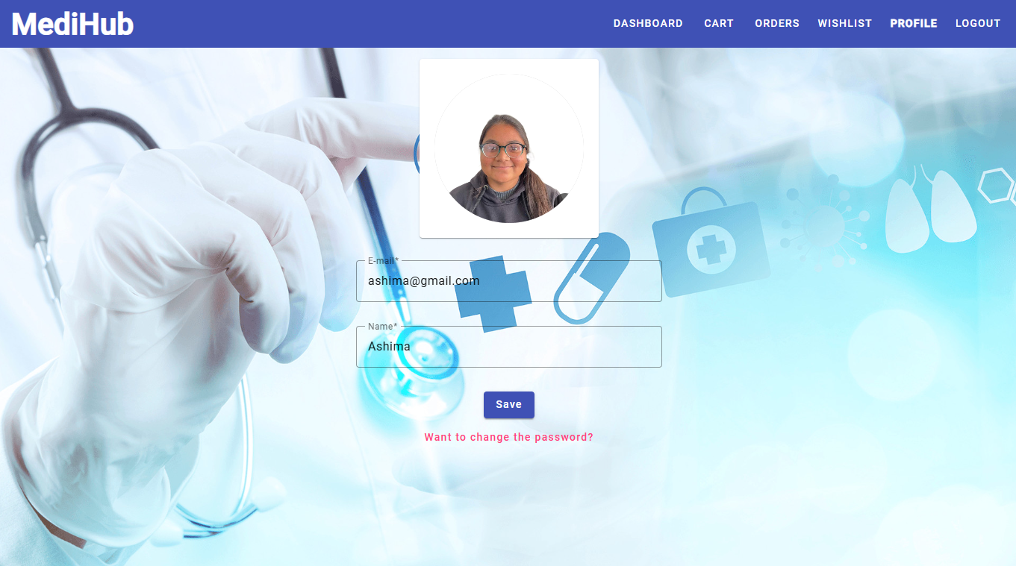
Snapshots

Slide 19
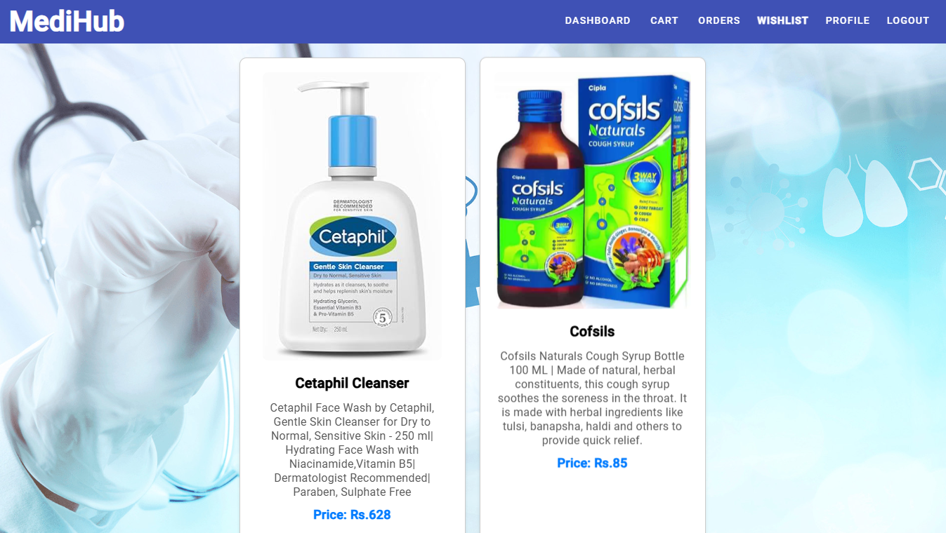
Snapshots

Slide 20
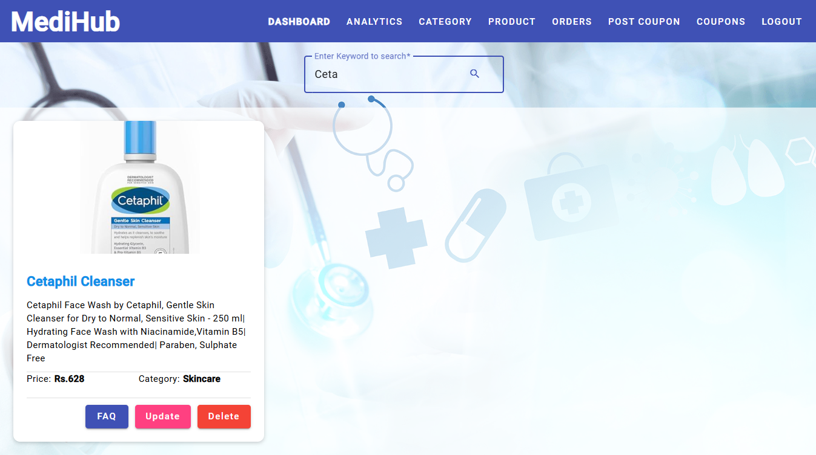
Snapshots

Slide 21
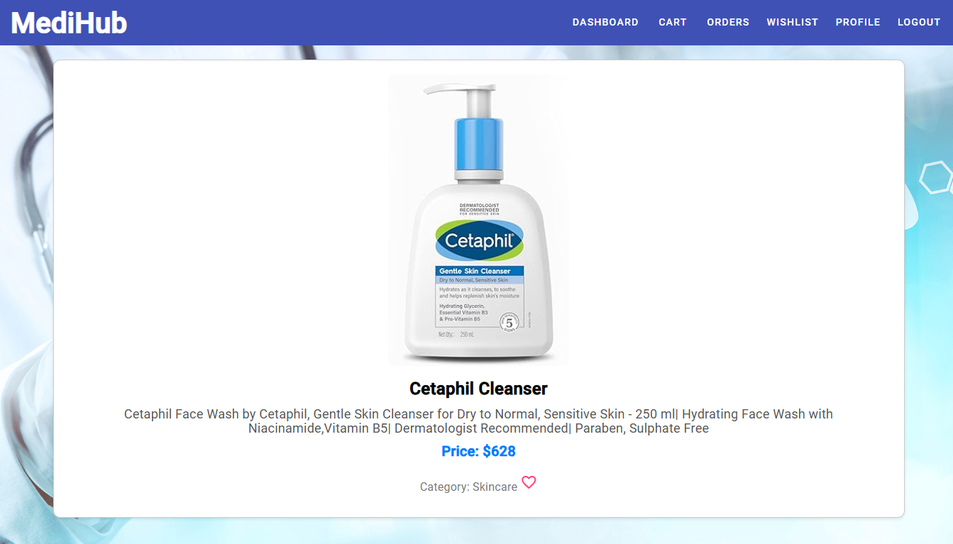
Snapshots

Slide 22
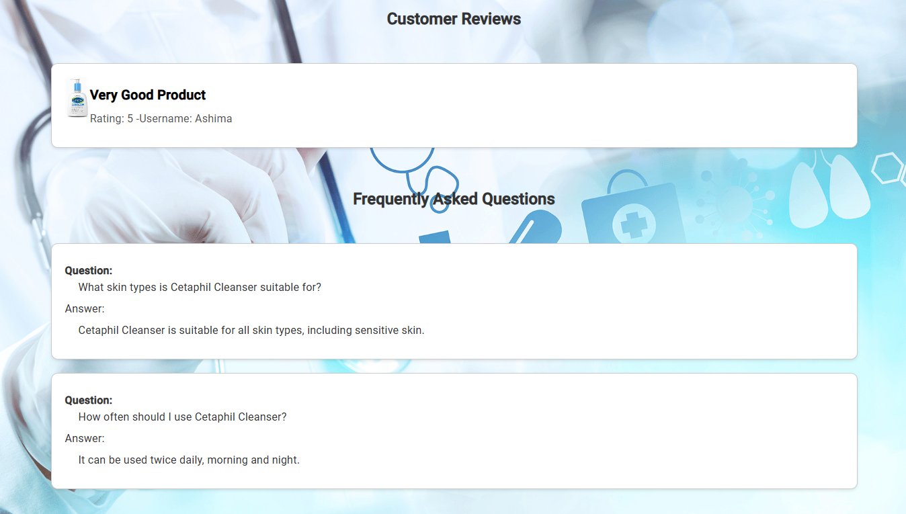
Snapshots

Slide 23
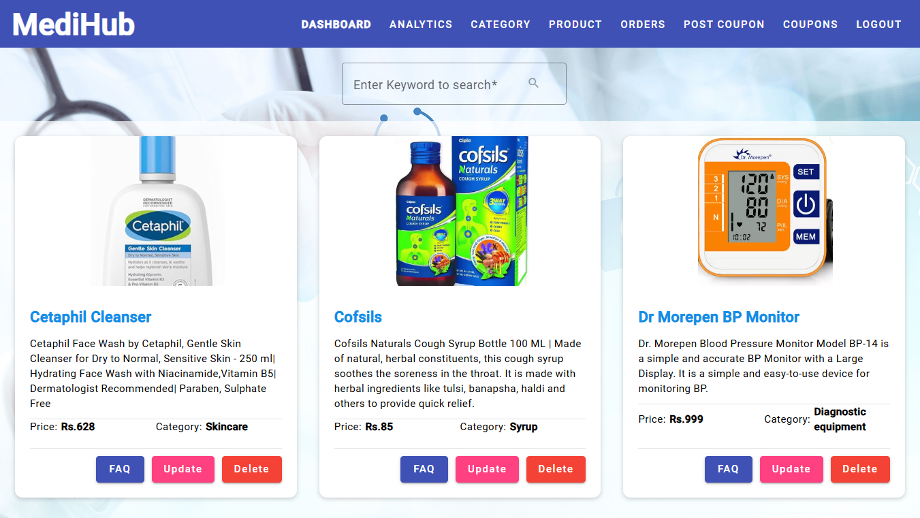
Snapshots

Slide 24
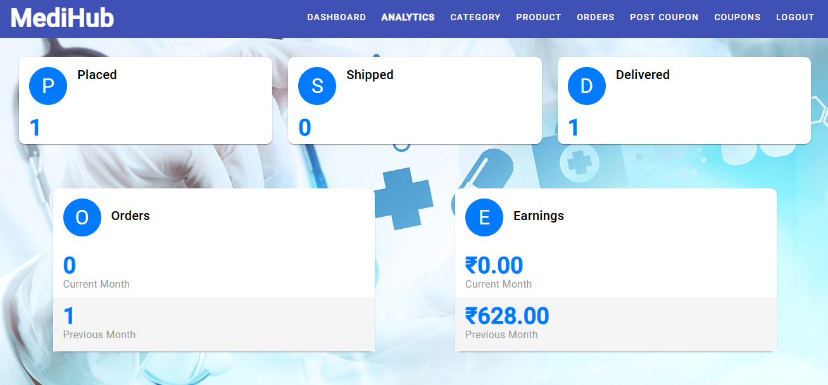
Snapshots

Slide 25
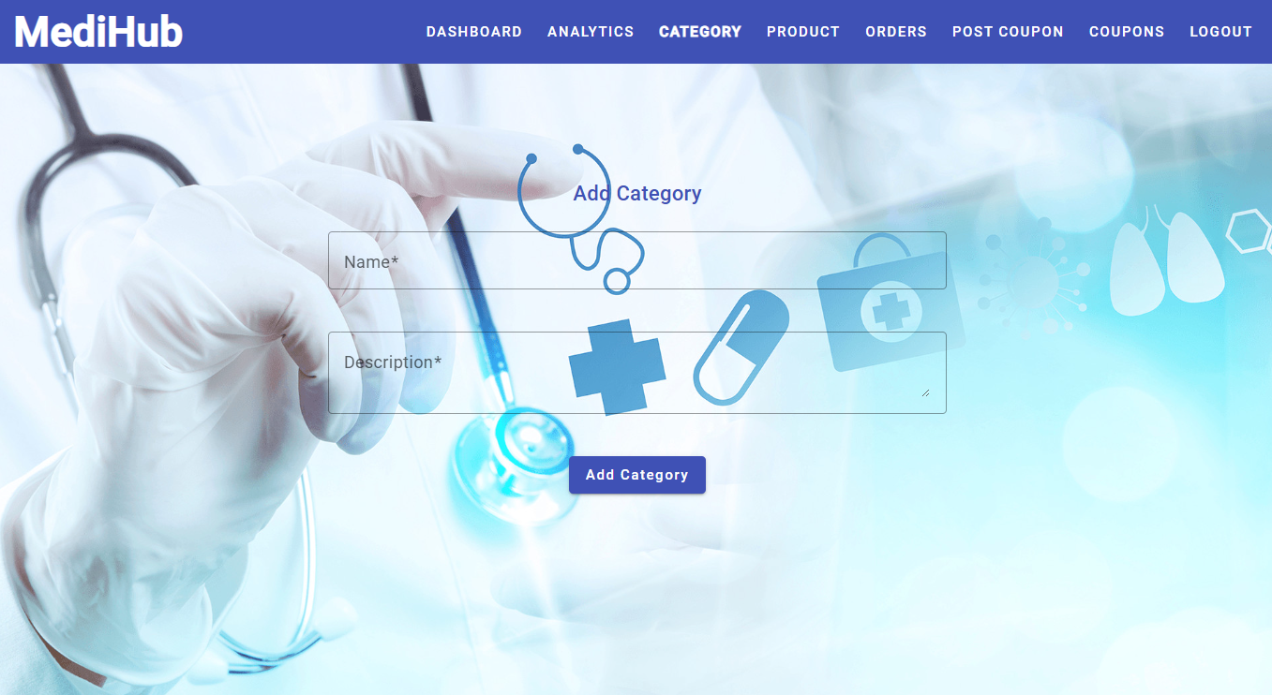
Snapshots

Slide 26
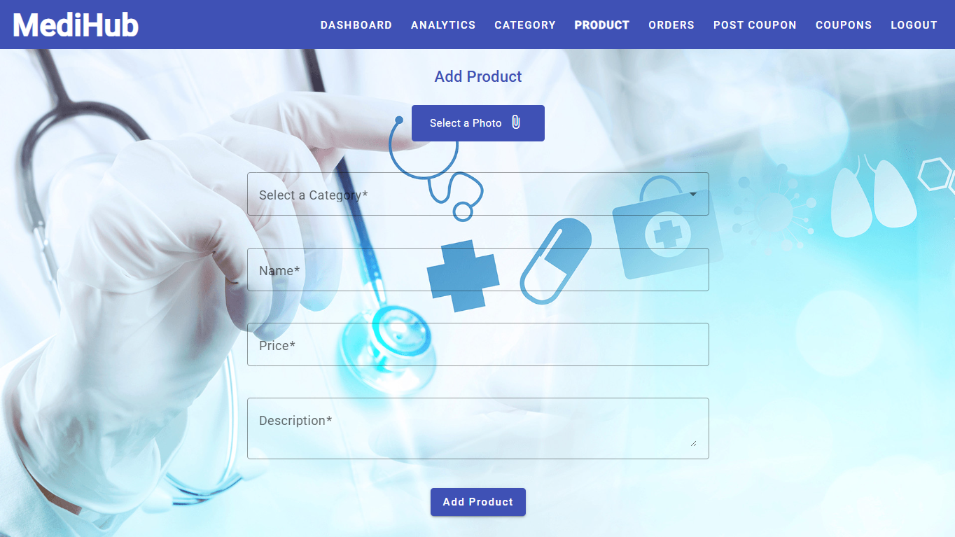
Snapshots

Slide 27
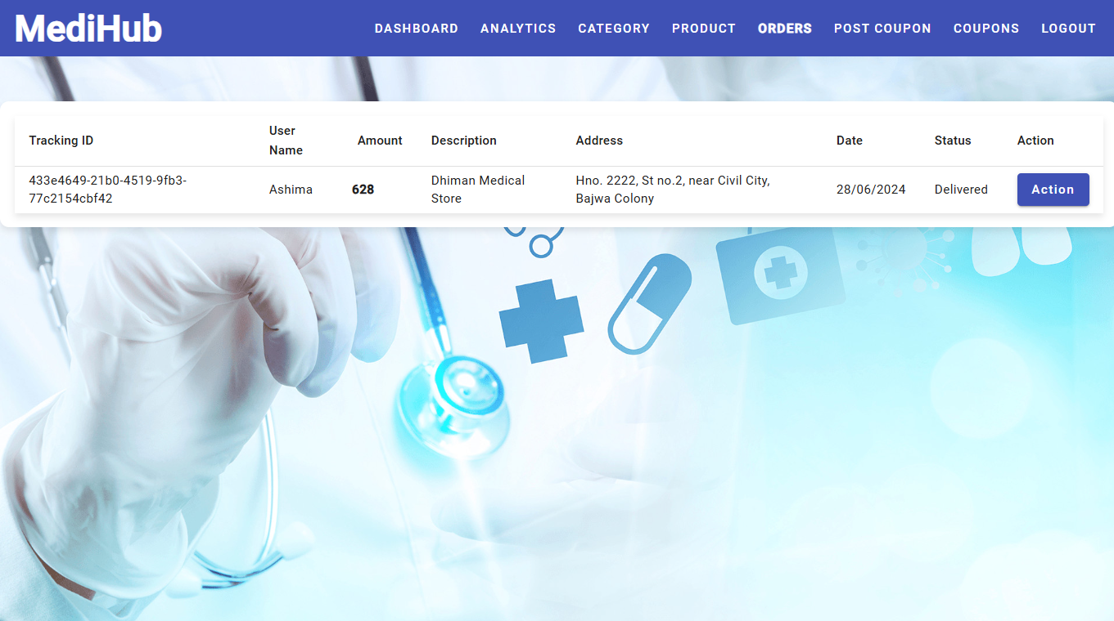
Snapshots

Slide 28
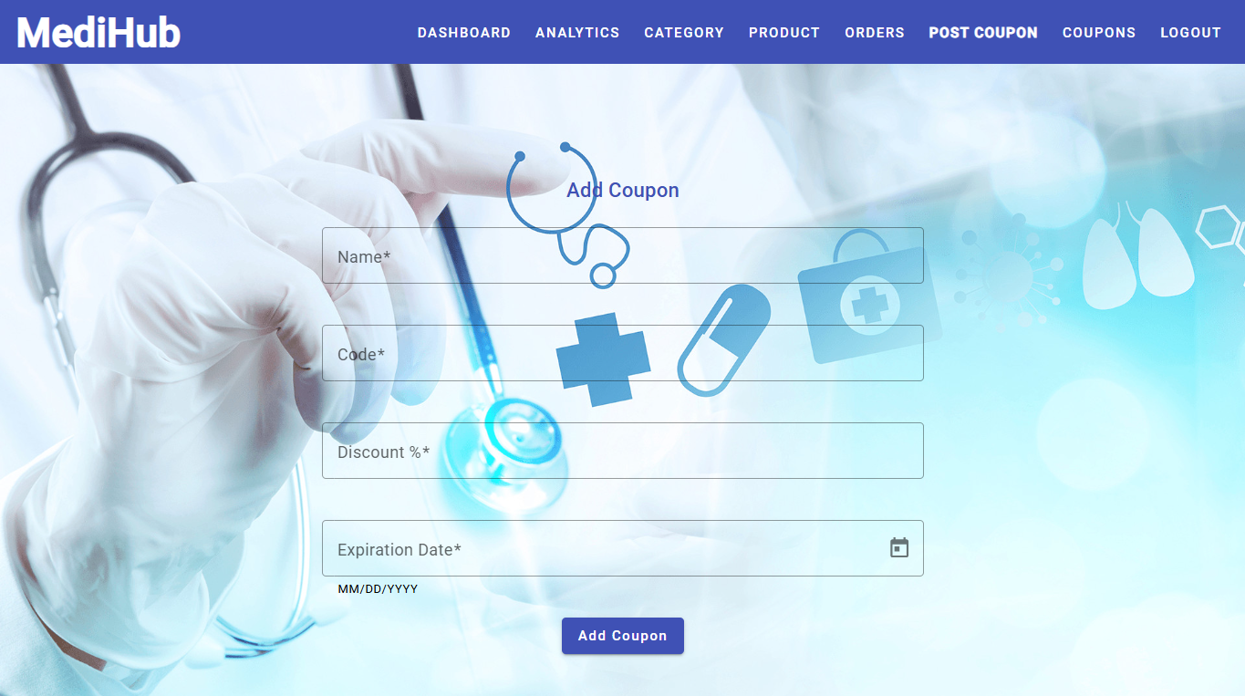
Snapshots

Slide 29
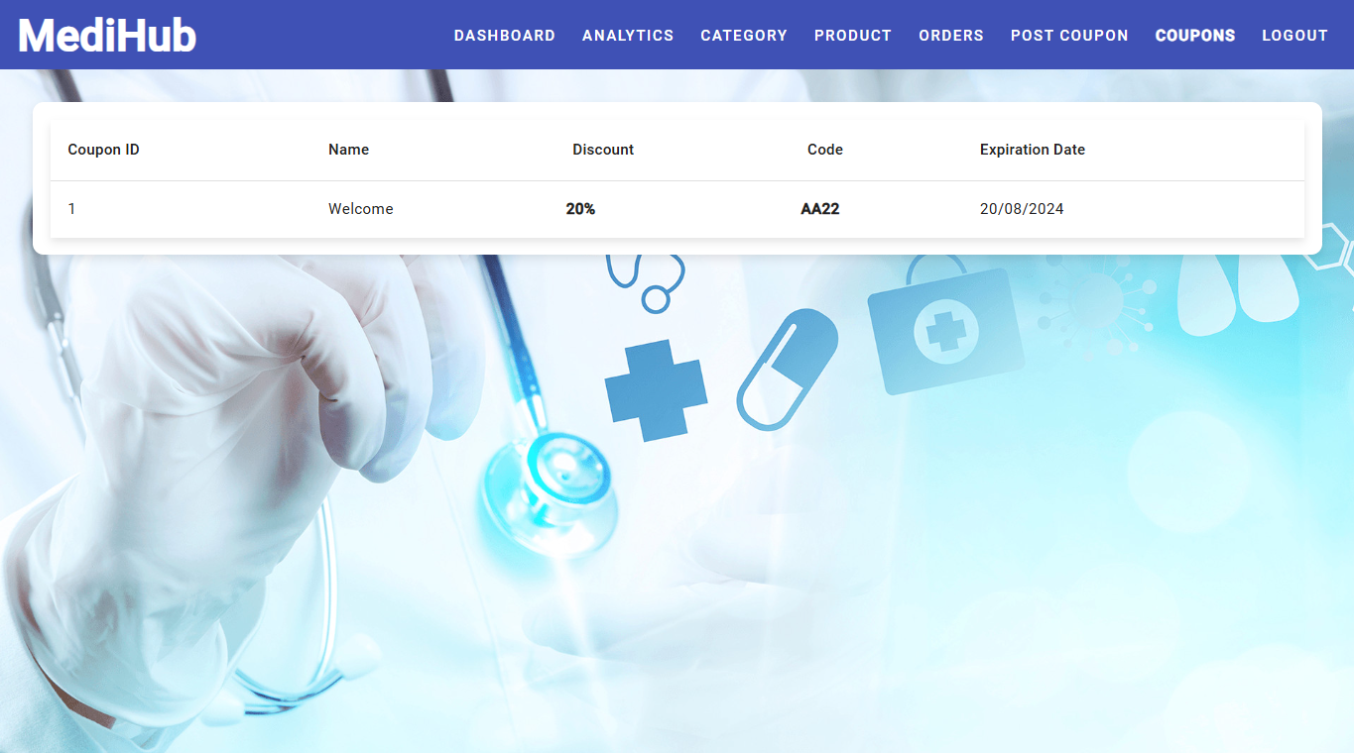
Snapshots

Slide 30
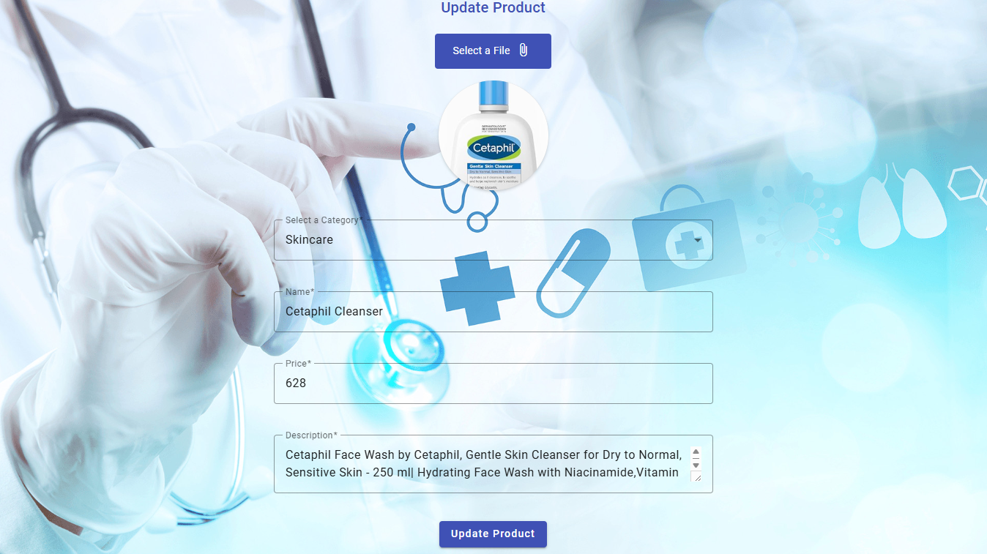
Snapshots

Slide 31
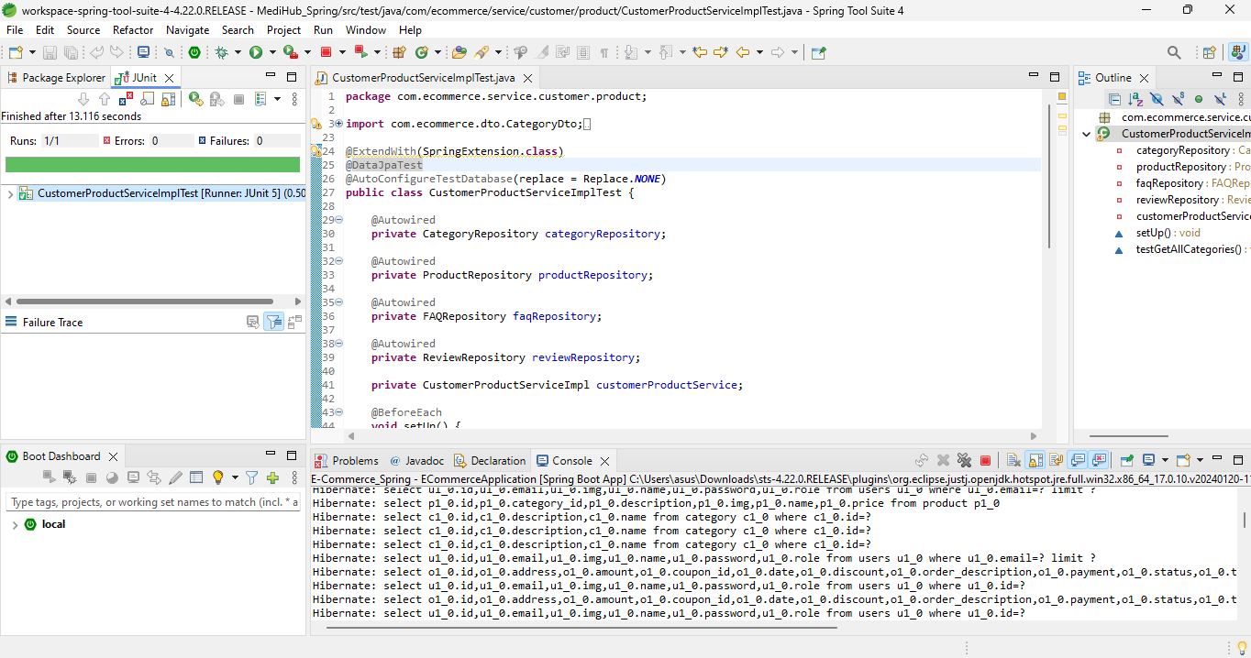
Snapshots - JUnit Testing

Slide 32
REFERENCES
https://www.oracle.com/technical-resources/articles/javase/servlets-jsp.html
https://www.geeksforgeeks.org/introduction-java-servlets/
https://www.netmeds.com/
https://pharmeasy.in/

Slide 33
Thankyou

